Slide 1
Armor Cotton Seed
WinField United Local Campaign
ATLAS Materials

Slide 2
Topic: Armor Cotton Seed
SUBJECT LINE: Growing Potential For Your Cotton
COPY:
Start 2021 Strong With Armor® Cotton
As a cotton farmer, you know the value of having strong, quality seed with the latest high-yielding genetics. It provides the strong start needed to maximize the plants yield potential. In addition, taking advantage of the latest weed- and worm-control technologies in your cotton helps reduce one additional worry during the growing season.
Armor Cotton provides best in class seed quality packaged with Bollgard® 3 XtendFlex® and Bollgard II® XtendFlex® weed and insect traits from Bayer. Our cotton products allow the use of glyphosate, glufosinate and dicamba, bringing together exceptional weed control and industry leading worm control. The additional mode of action in Bollgard 3 XtendFlex offers enhanced worm control for even higher yield potential.
You can find these attributes and more in the Armor Cotton line-up, which WinField United recently transitioned from CROPLAN® brand. The transition gives you the personalized service of the Armor brand backed by WinField United’s history of innovation in product development and agronomic expertise. Contact us to help you create a plan for your cotton crop with the right varieties and trait technologies for your operation.
For more information, visit armorseed.com.
Important: Before use always read and follow label instructions. Crop performance is dependent on several factors many of which are beyond the control of WinField United, including without limitation, soil type, pest pressures, agronomic practices, and weather conditions. Growers are encouraged to consider data from multiple locations, over multiple years, and be mindful of how such agronomic conditions could impact results.
© 2020 WinField United. Armor®, CROPLAN® and WinField® are trademarks of WinField United. Bollgard®, Bollgard II® and XtendFlex® are trademarks of Bayer Group.

Slide 3
Topic: Additional Resources
Product page, Armor brand cotton seed: https://armorseed.com/seeds/cotton
Bollgard 3 trait: https://traits.bayer.com/cotton/Pages/Bollgard-3-XtendFlex.aspx
Bollgard II trait: https://traits.bayer.com/cotton/Pages/Bollgard-2-XtendFlex.aspx
Social Channel: Facebook or Twitter
If you farm cotton, you know the value of the latest weed- and worm-control technologies, plus genetics that protect fiber quality and guard against diseases. Contact us to help determine which seed system is right for you.
Link to: [Insert retailer website here]

Slide 4
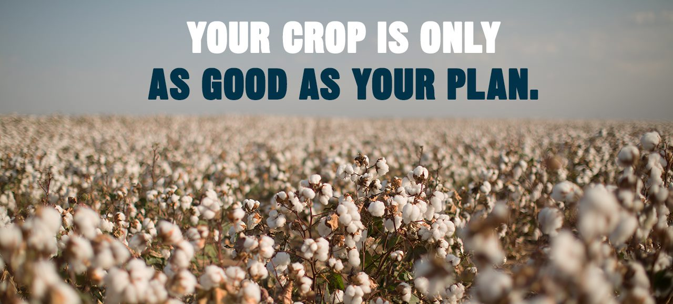
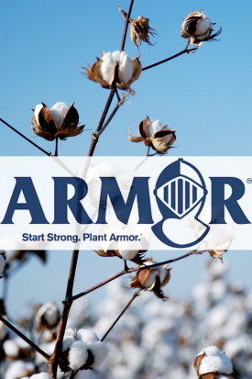
Email Images

